Slide 1
HUMAN
MACHINE
INTERFACE

Slide 2
Problem Statement
Develop a Human-Machine Interface (HMI) for a 6-axis robot that allows operators or users to interact with and control the robot system effectively.
The HMI serves as a bridge between the human operator and the robotic system, enabling intuitive control and monitoring of the robot's movements and tasks.
This Product should be developed through Qt Framework.

Slide 3
Wrist
Finger
Tip
Elbow
Shoulder
Base

Slide 4
Objectives
01
Our aim
02
The goal
The objective of this project is to develop a UI with a simulation that allows users to control the intricate movements of a 6-axis robotic arm with precision and ease. The UI will encompass a user-friendly design, allowing for intuitive action while enabling users to adjust movement speed for diverse tasks and also to record the xyz points of the arm.
Our ultimate goal is to sync the real world arm with our simulation which ensures a synchronized and cohesive experience and our foremost goal is to implement the automation by generating the commands automatically with the captured xyz points which advance its automation capabilities.

Slide 5

Now
Many existing robot control dashboards lacks feedback, simulation and synchronization, they focus only on emitting commands without assessing their impact on Arm. But some of them are with simulation but lacks in synchronization causing unintended outcomes an integrated solution is needed for accurate control, safety, and reliable performance.

Slide 6
Future
Our HMI incorporates real-time 3D simulation synced with the physical arm, ensuring consistent unit alignment for synchronized movements. Operators control arm speed for each axis, maintaining precise oversight. Captured X, Y, Z axis data furthers automation training. This overall integration promotes safety, accuracy, and automation efficiently.

Slide 7
Solutions
User-friendly interface to Control the movment of the Arm for each axis
The Control, Simulation and the hardware ARM will be Connected via TCP protocol for the sharing the data across.
Automatic command generation and movement tracking with the captured XYZ values.
Overall intergration ensures the consistency and integrity of the measurement between the Arm and Simulation.

Slide 8

Project timeline
Phase 1
Phase 2
Phase 3
Phase 4
Market research
Design Implementation
Backend Development
Simulation
Phase 5
Phase 6
Phase 7
Alpha Testing
Embedding
Outcome

Slide 9


Technology

Slide 10
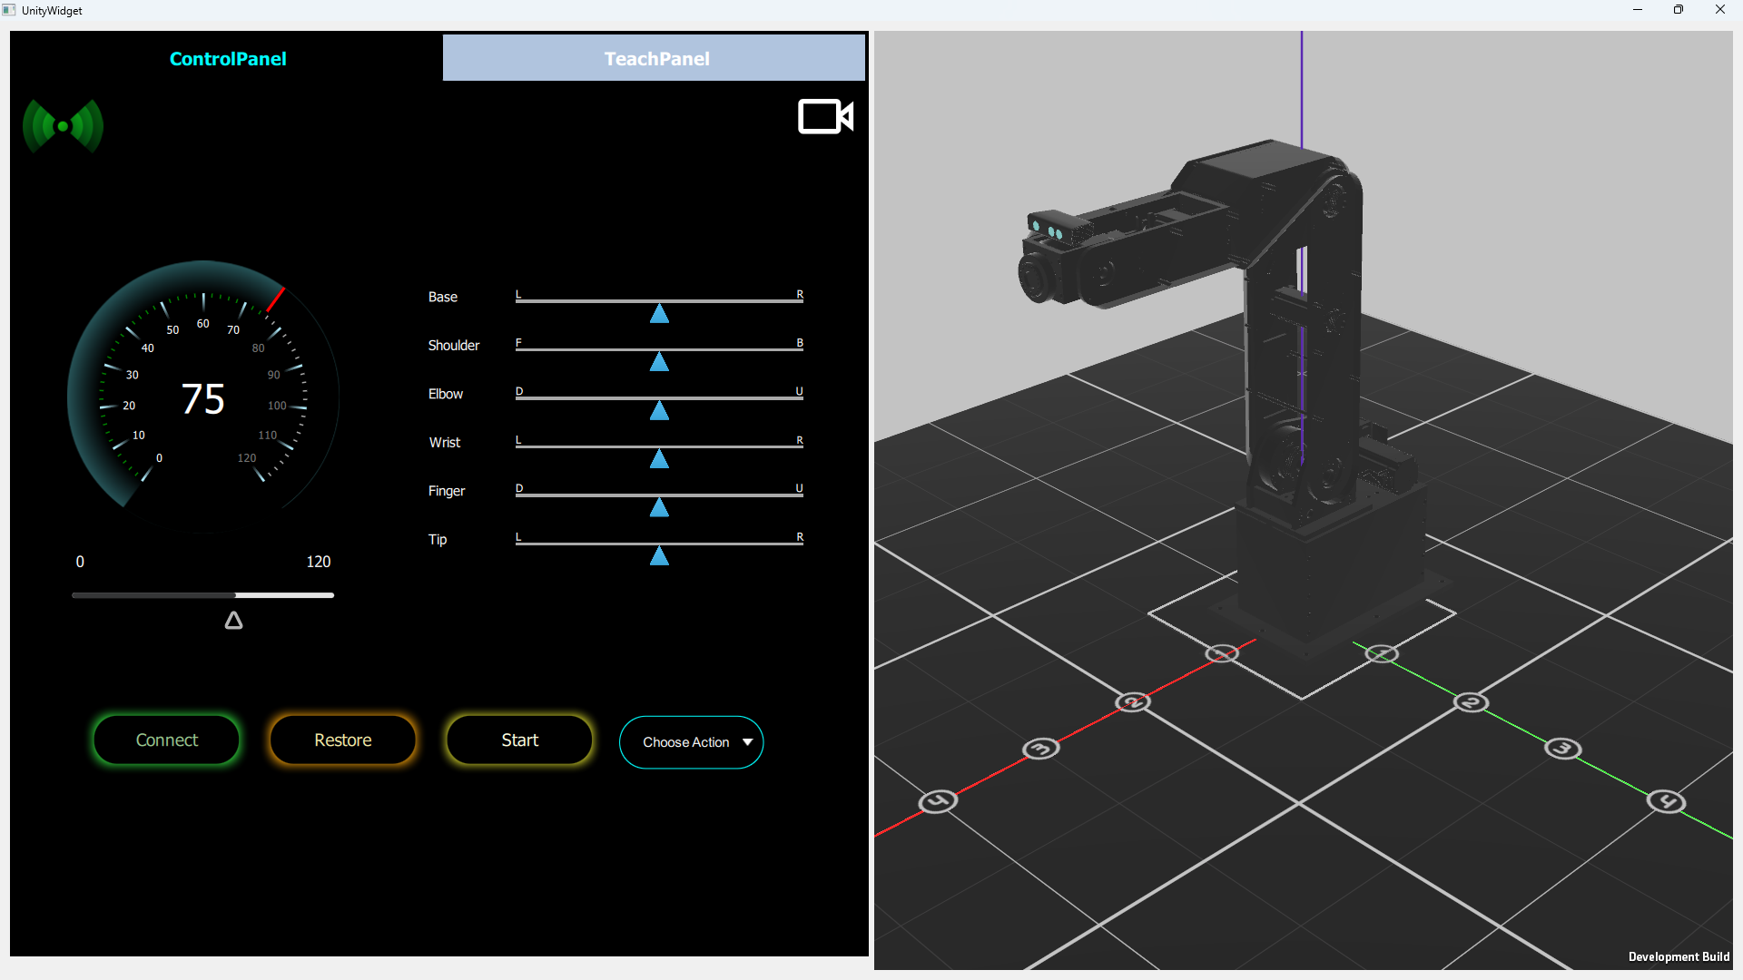
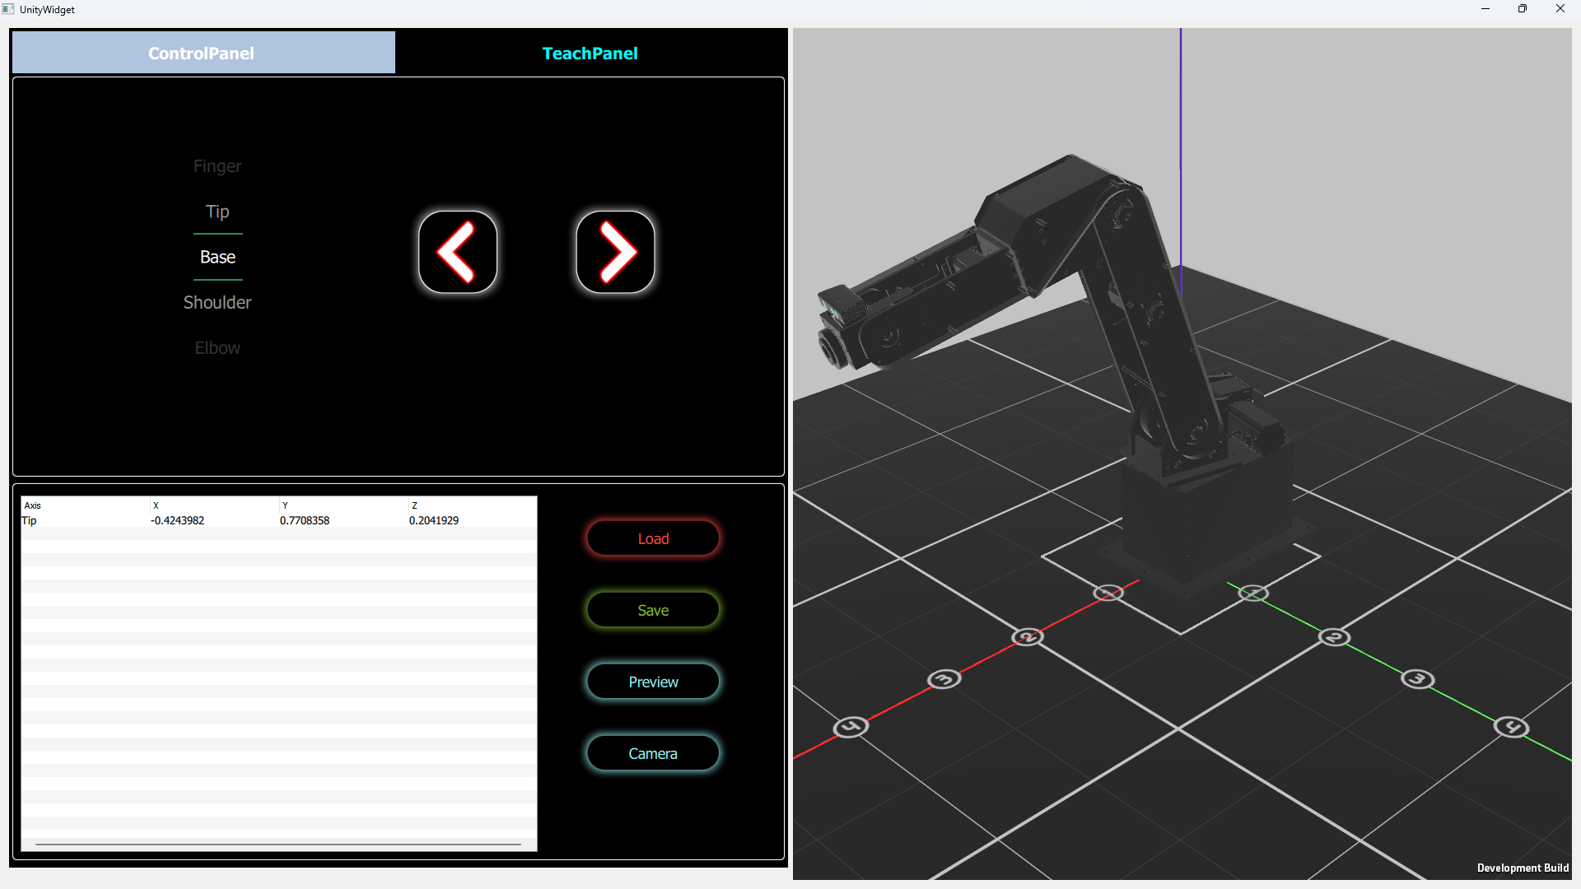

Slide 11
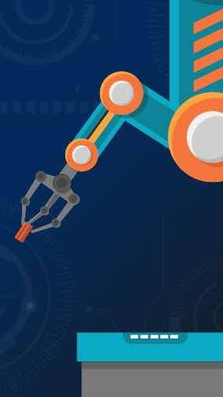
Budget
Embedded Kit 4GB ARM64
LCD Screen 7inch

